Slide 1

Part Two: JDBC Presentation

Slide 2
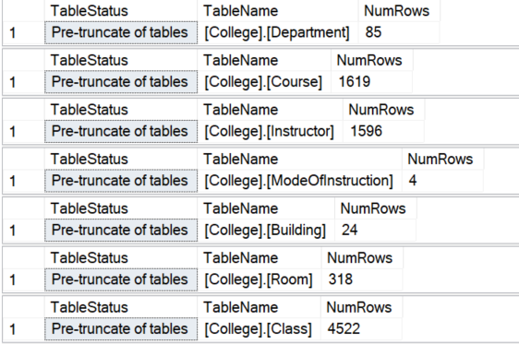
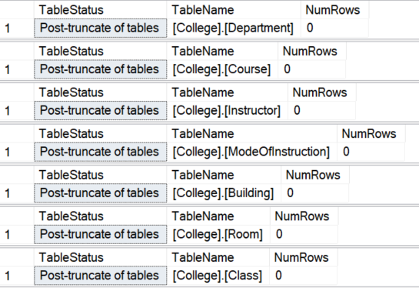
Project3.LoadQueensCourseSchedule
Pre Truncate:
Post Truncate:
Notes:
Steven

Slide 3
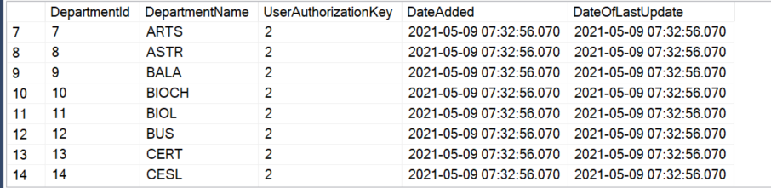
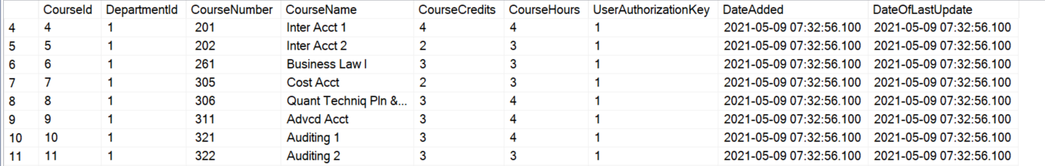
Project3.LoadQueensCourseSchedule
Notes:
Steven

Slide 4
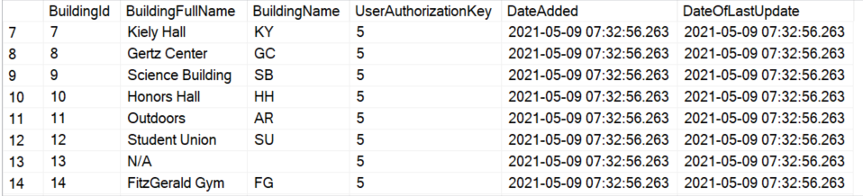
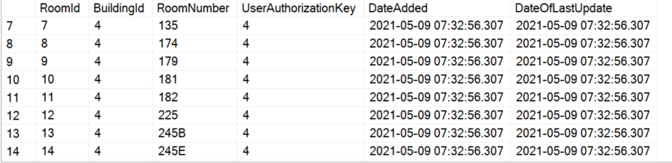
Project3.LoadQueensCourseSchedule

Slide 5
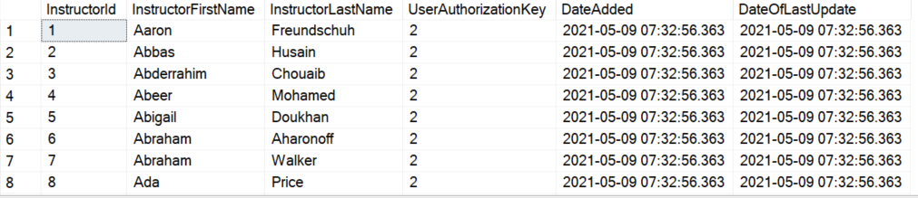
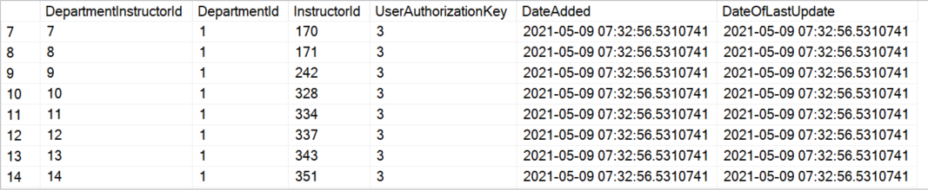
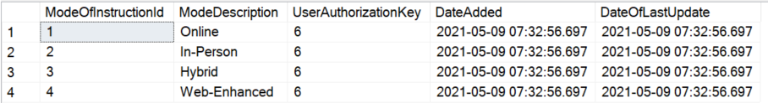

Slide 6
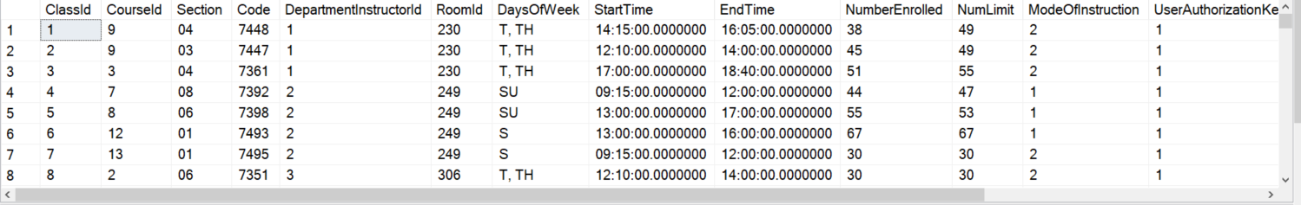
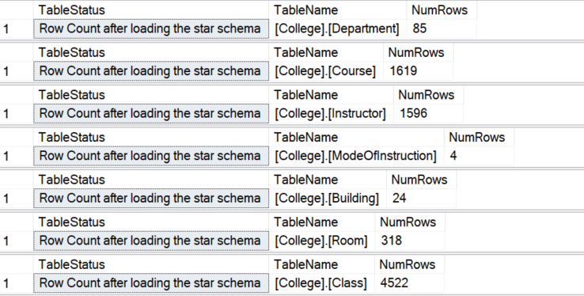

Slide 7
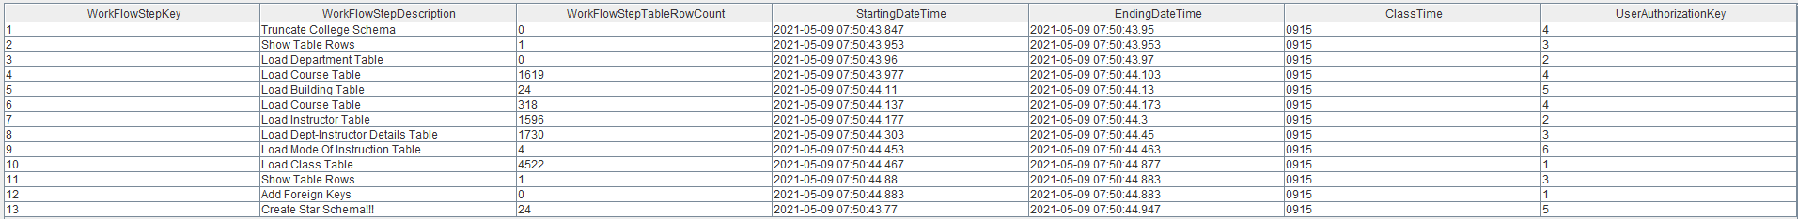
Process.usp_ShowWorkflowSteps
Notes:
Steven

Slide 8

Queries

Slide 9
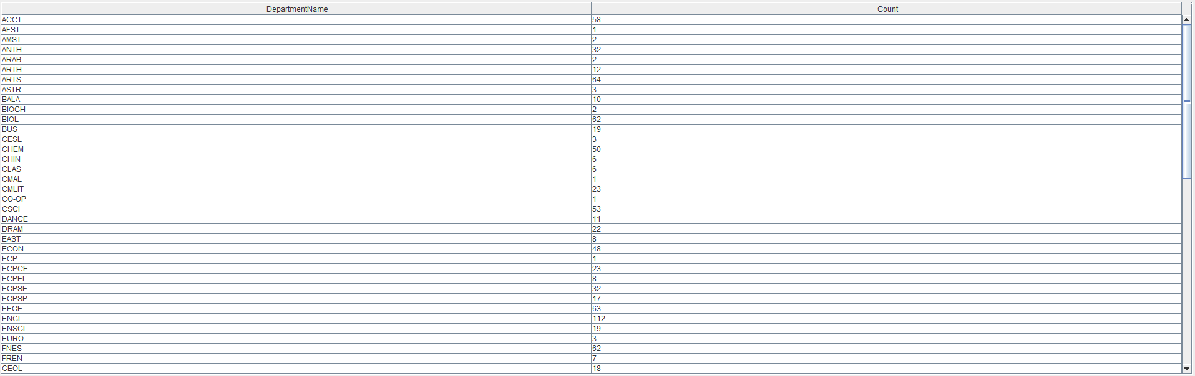
Query 1: How many instructors in each department
Notes:
Matin

Slide 10
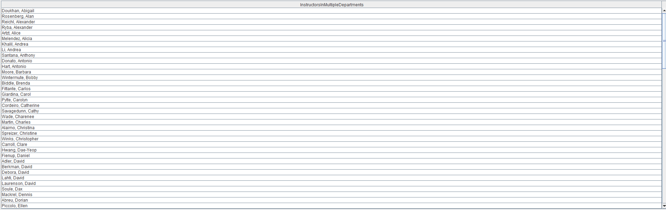
Query 2: Instructors in multiple departments
Notes:
Matin

Slide 11
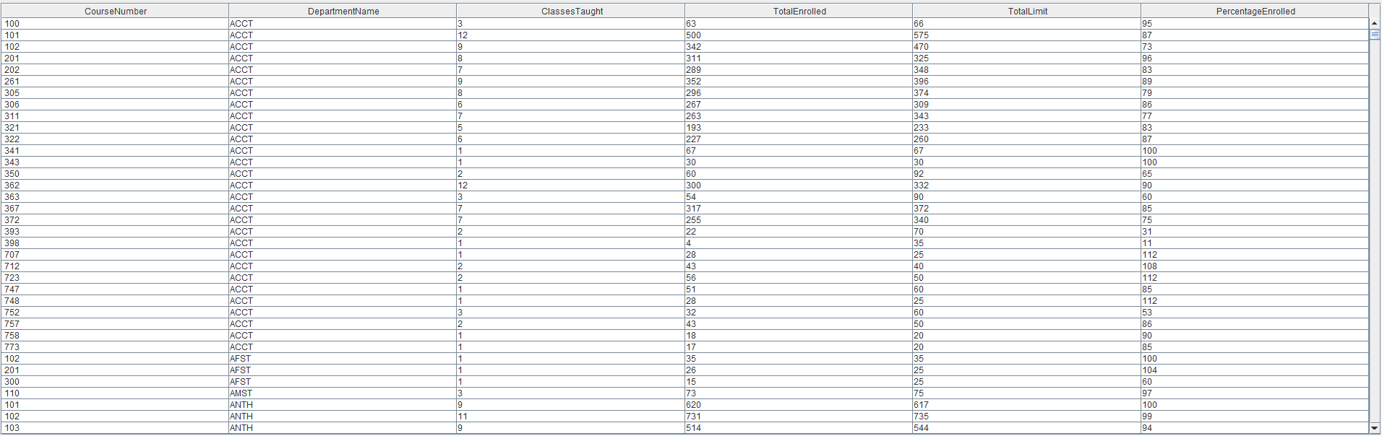
Query 3: How many classes that are being taught that semester
Notes:
Steven

Slide 12
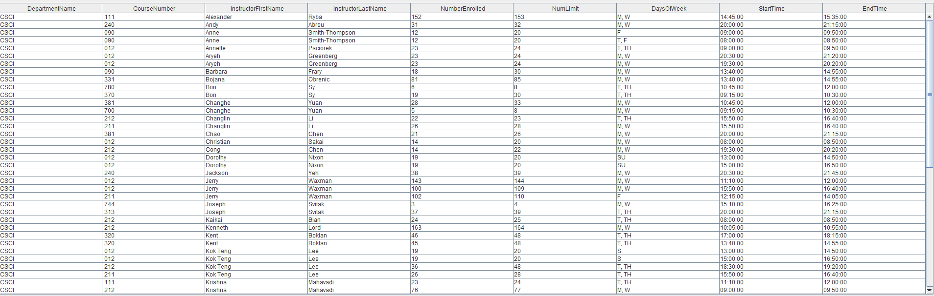
Query 4: Show all open CSCI courses
Notes:
Steven

Slide 13
Query 5: Heller or the highway
Notes:
Steven

Slide 14
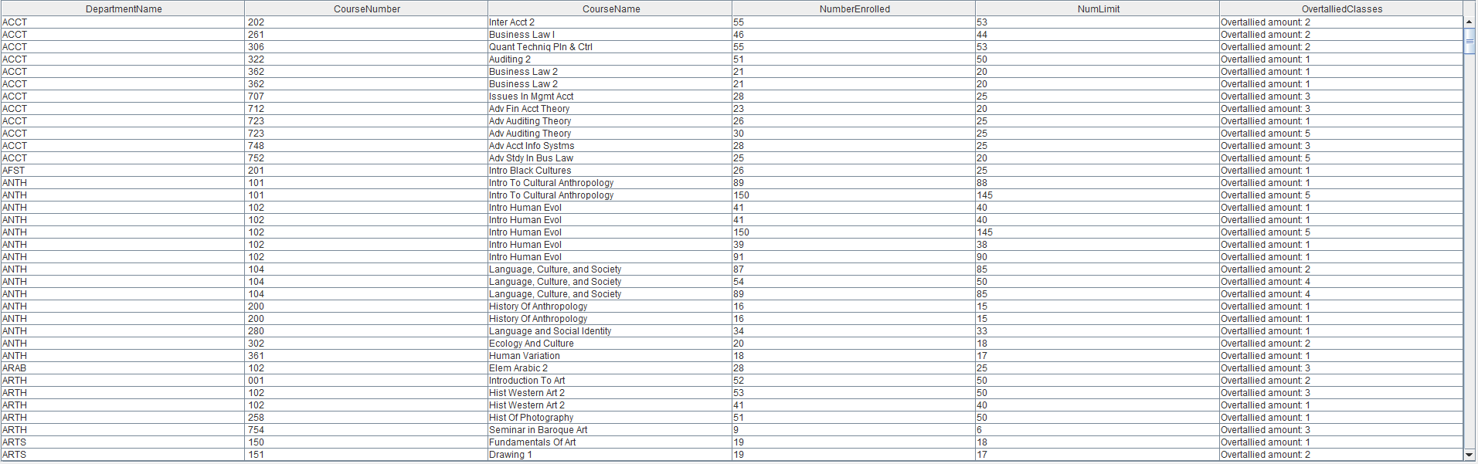
Query 6: Show over tallied courses
Notes:
Humaira

Slide 15
Query 7: Enrollment per mode of instruction
Notes:
Humaira

Slide 16
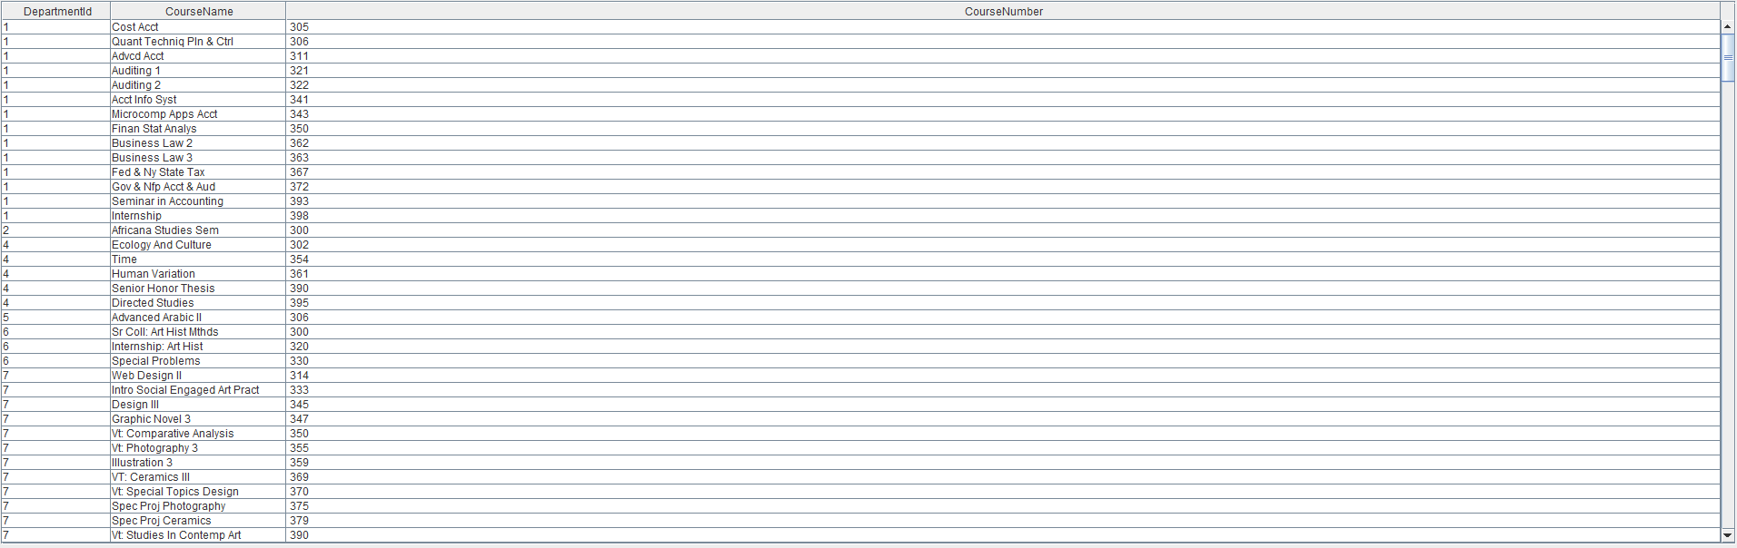
Query 8: Find all 300+ level courses offered at Queens College
Notes:
Ensar

Slide 17
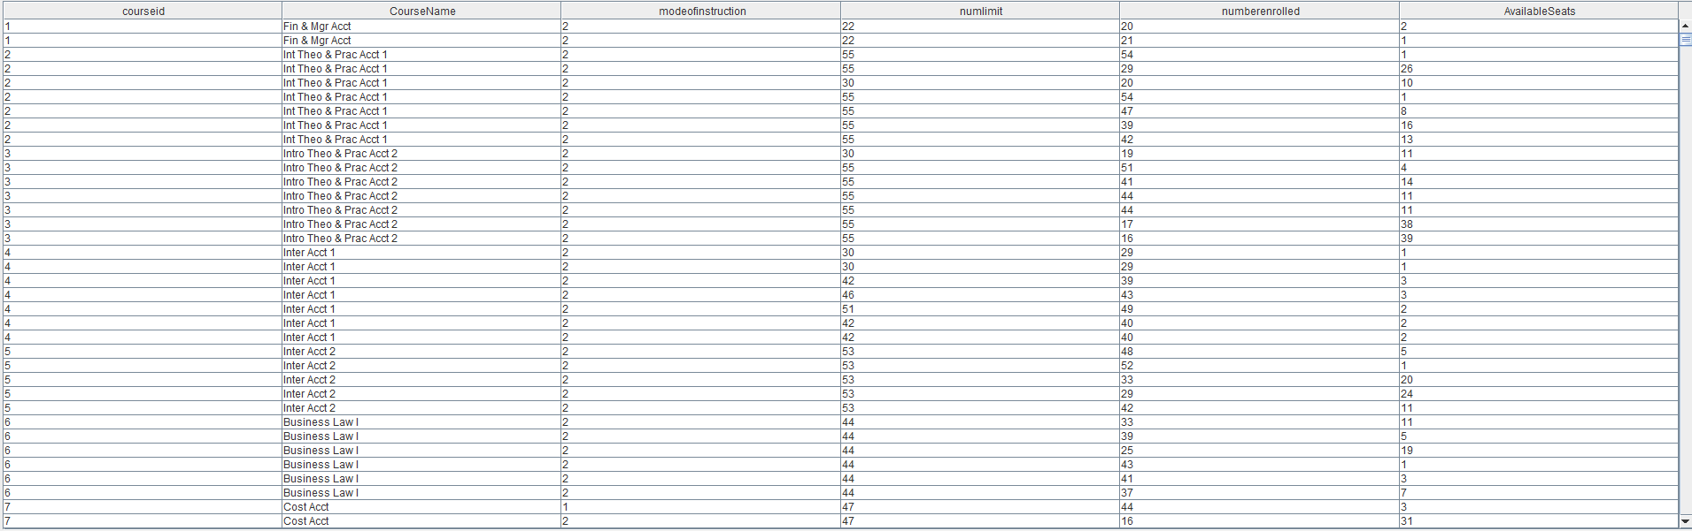
Query 9: Find all open courses and the number of available seats.
Notes:
Sharlene

Slide 18
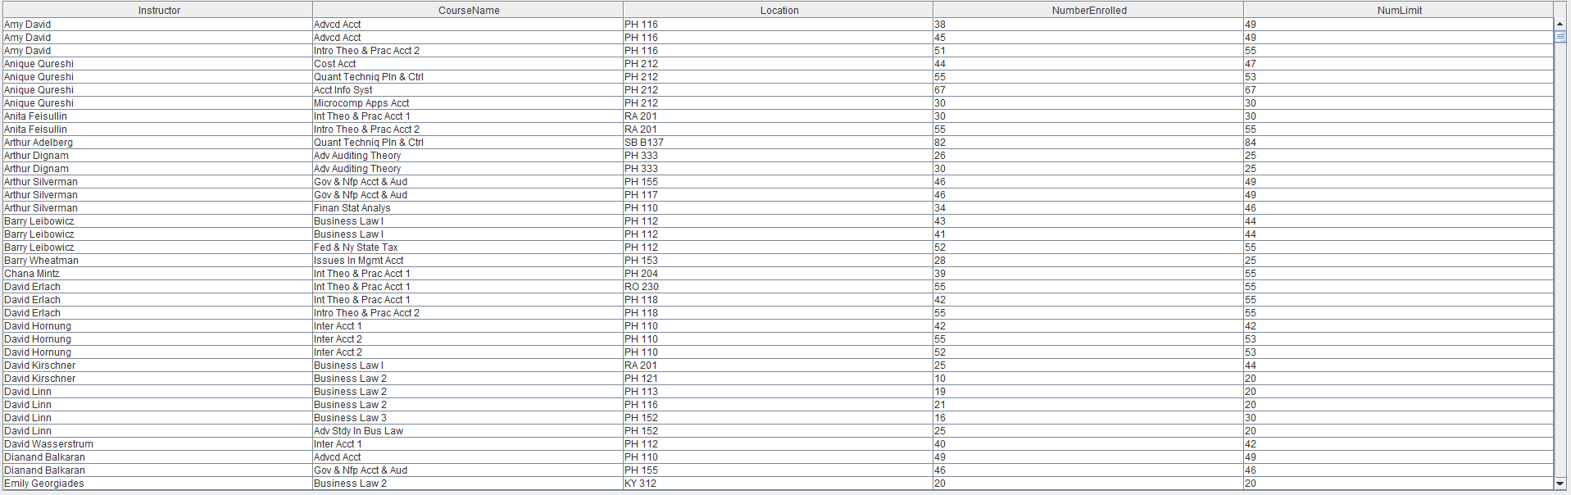
Query 10: Finds all class information for in person classes
Notes:
Luis

Slide 19
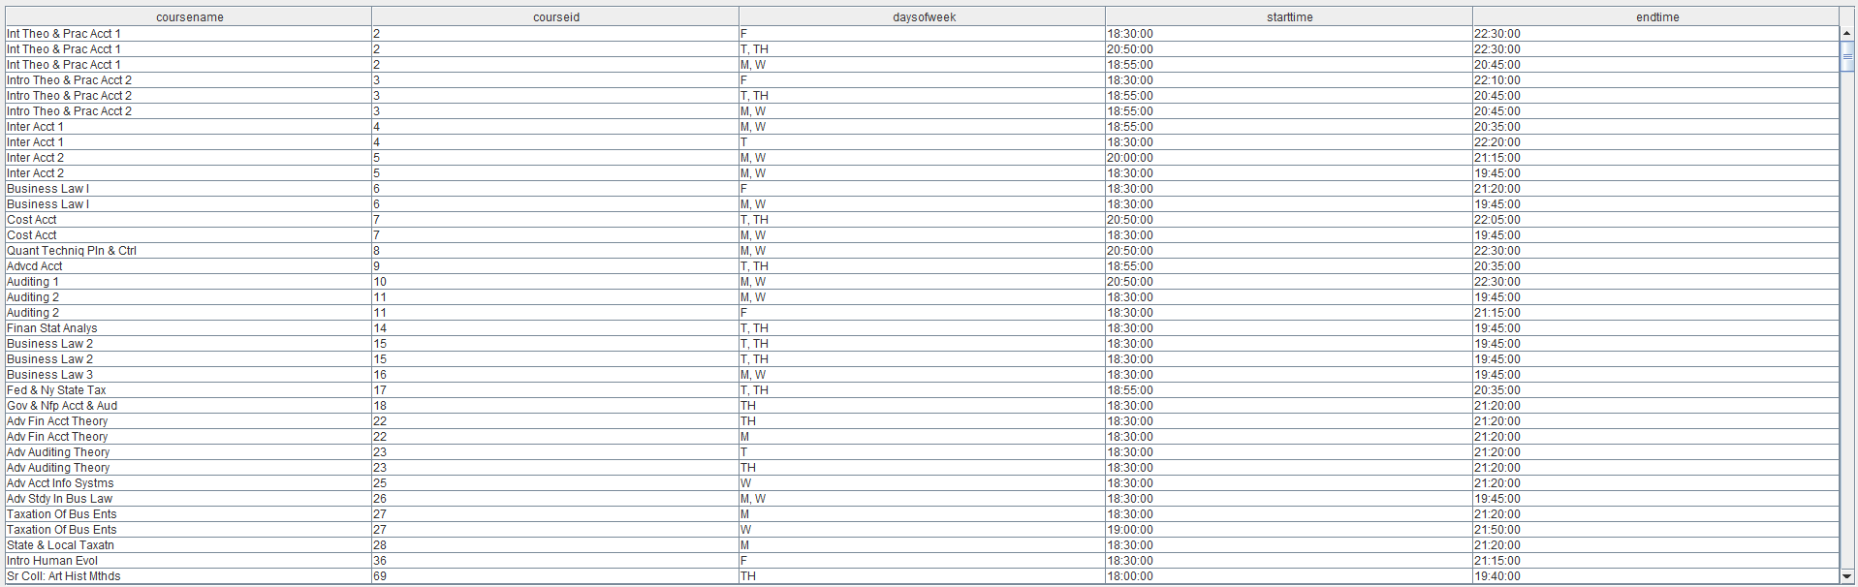
Query 11: All night-time classes
Notes:
Sharlene

Slide 20
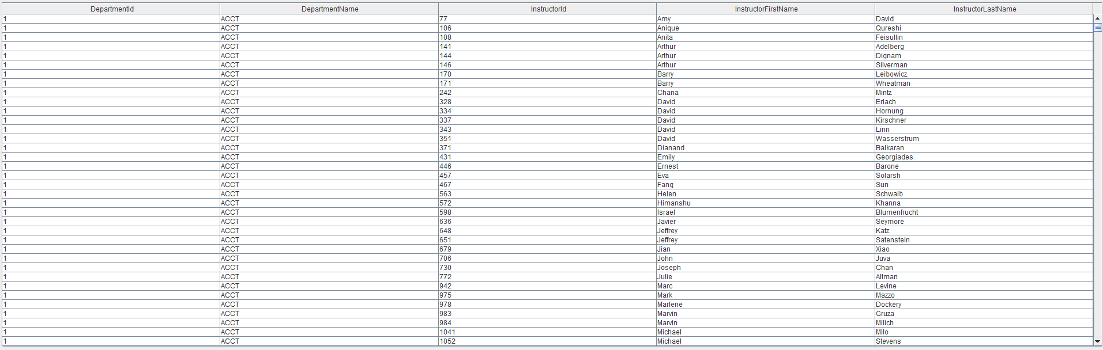
Query 12: Returns professor names and the departments they work in
Notes:
Ensar

Slide 21
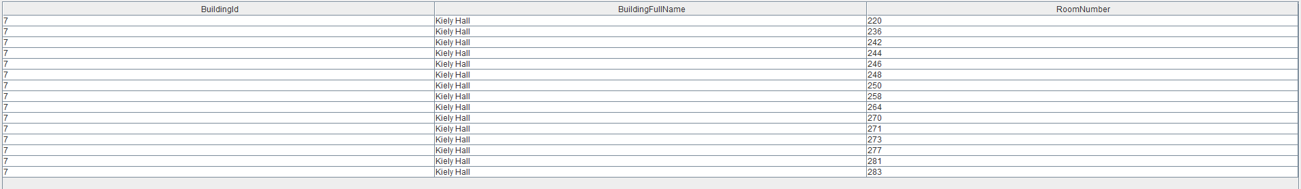
Query 13: Finds all rooms that are actively being used by classrooms in Kiely Hall on the second floor.
Notes:
Sharlene

